Slide 1


Slide 2
What is TypeScript?
TypeScript is a programming language developed and maintained by Microsoft. It is a strict syntactical superset of JavaScript and adds optional static typing to the language. Typescript is designed for the development of large applications and transcompiles to JavaScript

Slide 3
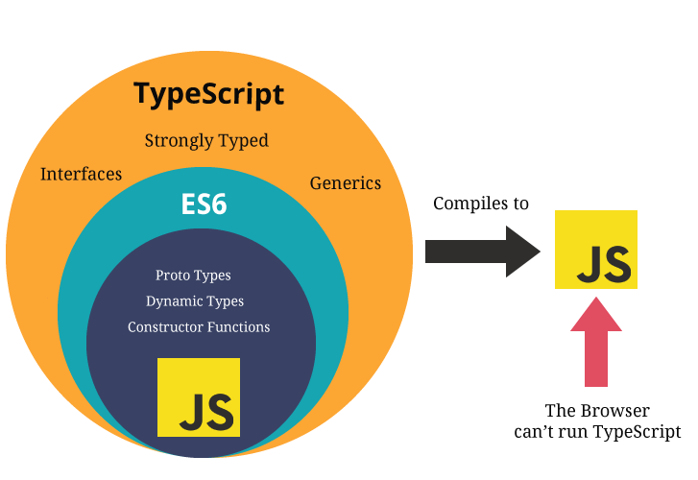

Slide 4
TypeScript - Class
TypeScript offers full support for the class keyword introduced in ES2015.
As with other JavaScript language features, TypeScript adds type annotations and other syntax to allow you to express relationships between classes and other types.
Example:-
class Car {
//field
engine:string;
//constructor
constructor(engine:string) { this.engine = engine }
//function
disp():void { console.log("Engine is : "+this.engine) } }

Slide 5
TypeScript - Variables
Variable names can contain alphabets and numeric digits.
They cannot contain spaces and special characters, except the underscore (_) and the dollar ($) sign.
Example:-
class Car {
//field
engine:string;
//constructor
constructor(engine:string) { this.engine = engine }
//function
disp():void { console.log("Engine is : "+this.engine) } }

Slide 6
TypeScript - Variables
Const: Variables can be declared using const similar to var or let declarations. The const makes a variable a constant where its value cannot be changed. Const variables have the same scoping rules as let variables.
var : Variables in TypeScript can be declared using var keyword, same as in JavaScript. The scoping rules remains the same as in JavaScript.
let : To solve problems with var declarations, ES6 introduced two new types of variable declarations in JavaScript, using the keywords let and const. TypeScript, being a superset of JavaScript, also supports these new types of variable declarations.

Slide 7
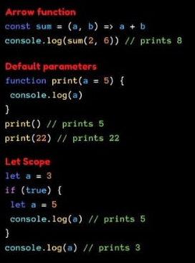
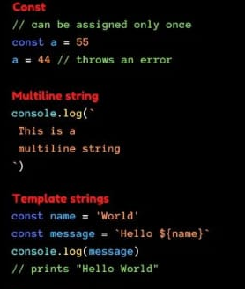
TypeScript

Slide 8
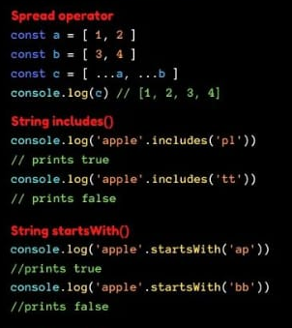
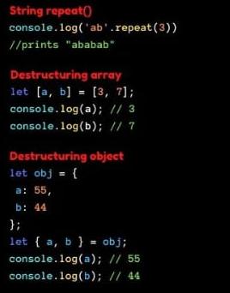
TypeScript

Slide 9
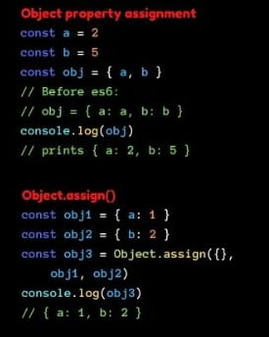
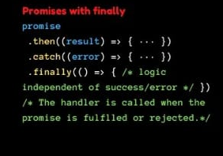
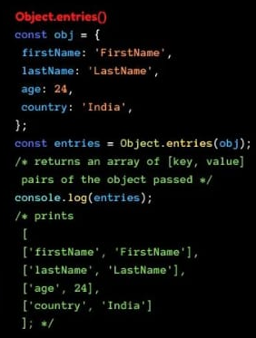
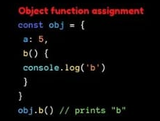
TypeScript

Slide 10
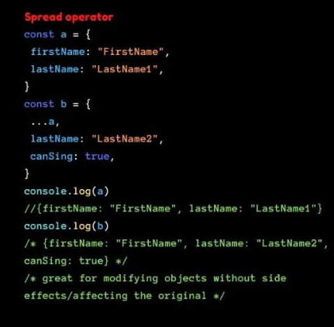
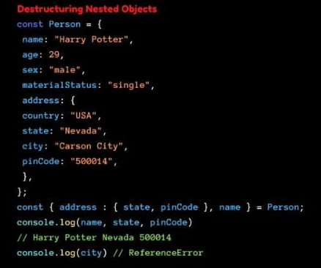
TypeScript

Slide 11
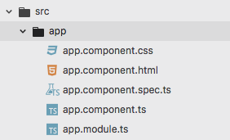
Angular Creating Components
Angular is based on components.
There is already the main component called app.component that shows the “Wellcome to App” page when you access localhost:4200
Angular component have 3 basics parts.
name-component.html (the html code of component)
name-component.css (css style of component)
name-component.ts (the typescritp of component)

Slide 12
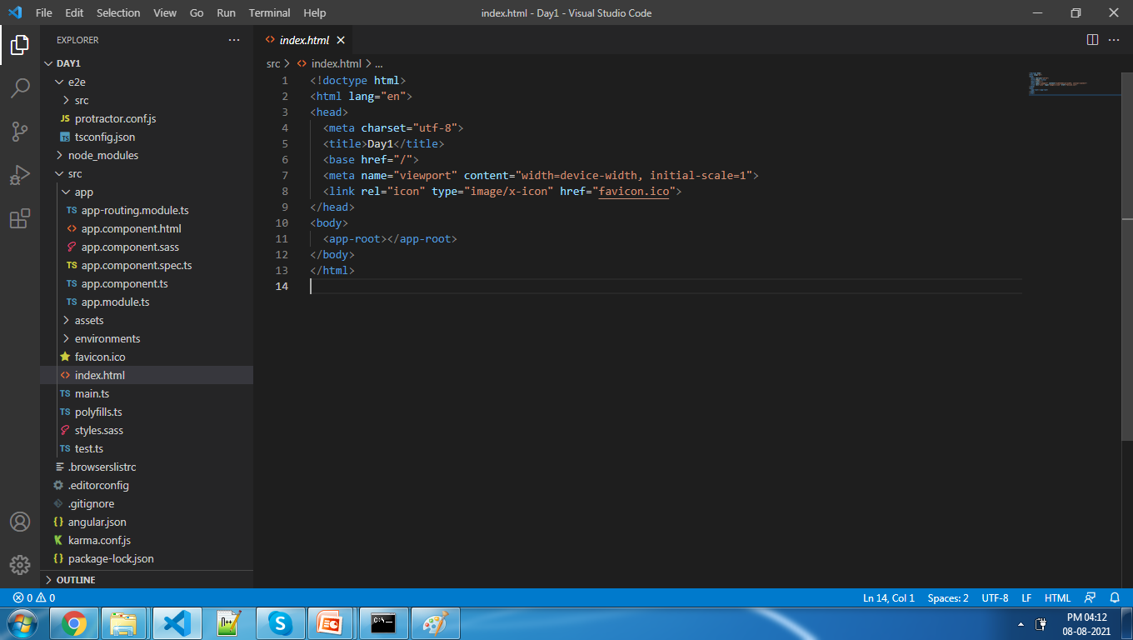
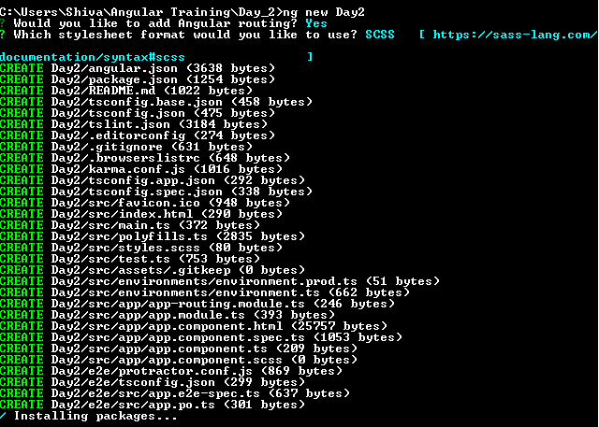
Angular Create a new Project

Slide 13
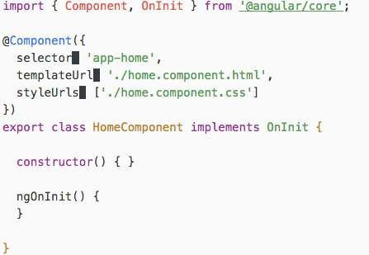
Angular Creating Components

Slide 14
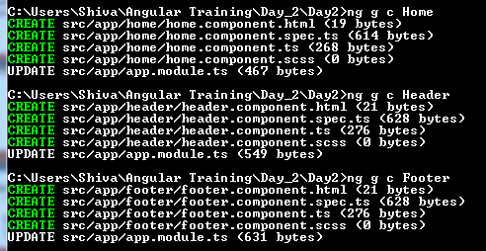
ng generate component xyz
ng generate component xyz
~ng generate component Home
~ng generate component Header
~ng generate component Footer

Slide 15
providers: Resources that will be injected into the component constructor
selector: The query selector that will find the element in the HTML and replace by the component
styleUrls: Array of path to style files
styles: Inline styles. NOTE: DO NOT use this parameter with require, it works on development but when you build the application in production all your styles are lost
templateUrl: Path to a HTML file
template: String that contains your HTML

Slide 16
















Two-way Data Binding
ONE WAY DATA B INDING TWO WAY DATA B INDING
VIEW
TEMPLATE
Change in view Updates model
change in model Updates
VIEW
One- time Merge
CONTINUOUS UPDATE
TEMPLATE
Model
Model
Change in model Updates view

Slide 17
That’s All For Today Day-1 !!
Questions?

Slide 18
Var vs Let
Yesterday Question

Slide 19
Thank You
shiva1991@live.com

